Slide 1
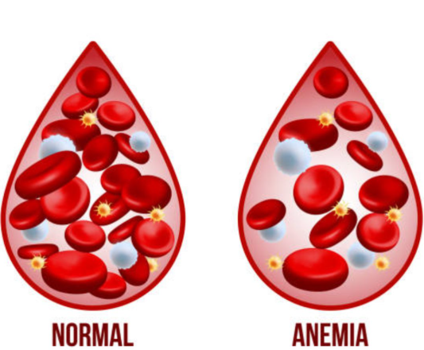
Early Detection of Anaemia Using Machine Learning

Slide 2
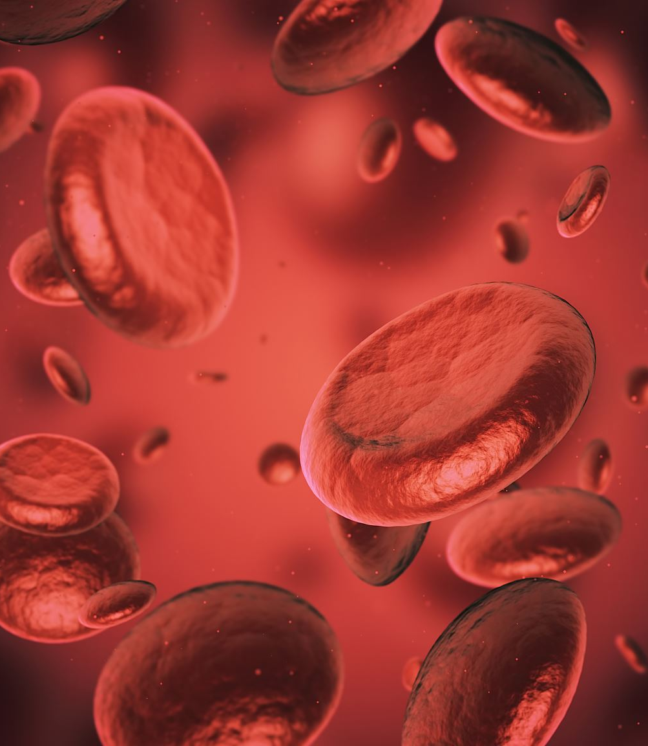
Problem Background
Anaemia is a common blood disorder that occurs when the body does not have enough healthy red blood cells or haemoglobin to carry oxygen efficiently. It affects more than one billion people worldwide and can lead to fatigue, organ damage, pregnancy complications, and a reduced quality of life if left untreated.
Early detection is extremely important, because different types of anaemia require different treatments. However, traditional diagnosis relies on laboratory blood tests and expert interpretation, which can be expensive, time-consuming, and difficult to access in low-resource or rural settings. This creates an opportunity for data-driven approaches, such as machine learning, to assist with faster and more accessible screening.

Slide 3

Project Objective
The main objective of this project was to use machine learning techniques to detect and classify different types of anaemia using routine blood test parameters. We aimed to compare several machine learning models and evaluate how accurately they can distinguish between healthy individuals and different anaemia types.
Ultimately, the goal was to identify the most accurate and reliable model that could serve as a decision-support tool for healthcare professionals, especially in early screening scenarios.

Slide 4
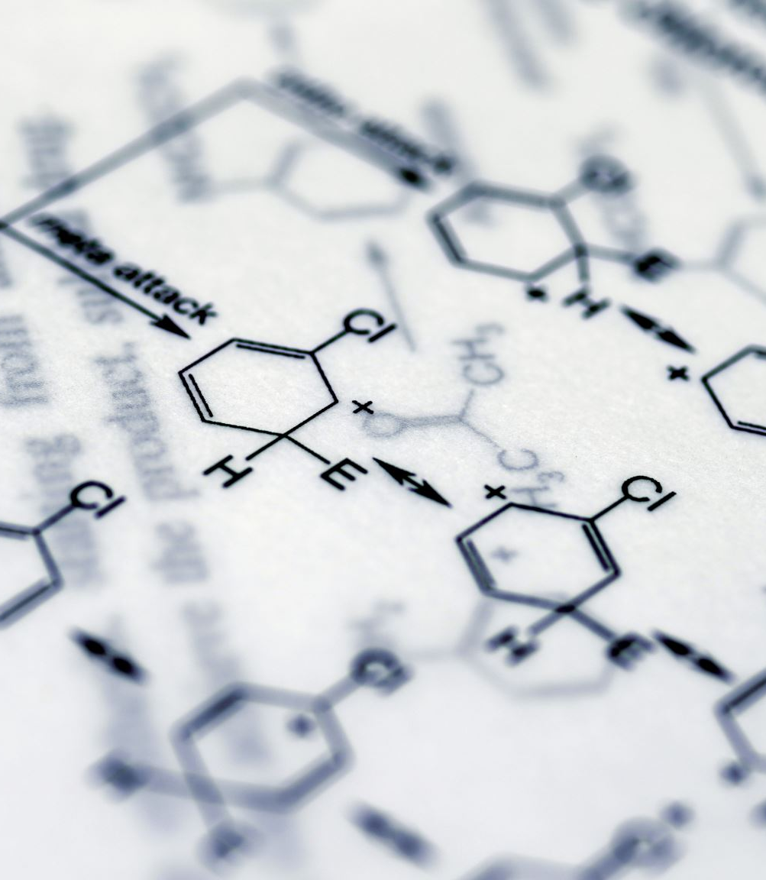
Dataset Description
The dataset used in this study consists of routine haematological parameters commonly found in complete blood count tests. These include features such as haemoglobin (HGB), red blood cell count (RBC), mean corpuscular volume (MCV), mean corpuscular haemoglobin (MCH), and mean corpuscular haemoglobin concentration (MCHC).
Each record in the dataset is labelled as either healthy or as a specific type of anaemia. The dataset contains multiple anaemia classes, and an important characteristic is that the classes are imbalanced, meaning some anaemia types appear far more frequently than others. This imbalance needed to be carefully considered during modelling and evaluation.

Slide 5

Data Preprocessing
Before training any models, the data was carefully cleaned and preprocessed to ensure reliable results. Duplicate records were identified and removed to prevent bias and artificial performance inflation.
The categorical diagnosis labels were then encoded into numerical values so they could be used by machine learning algorithms. After that, the dataset was split into training and testing sets to allow for fair model evaluation.
Finally, feature scaling was applied using StandardScaler, ensuring that all numerical features contributed equally to the learning process. Class weighting was also used to address the class imbalance problem.

Slide 6

Models Used
Several supervised machine learning models were implemented and compared in this study. These include Logistic Regression, Support Vector Machine, Decision Tree, Random Forest, and Gradient Boosting.
Each model represents a different learning strategy.
Logistic Regression was used as a simple and interpretable baseline model. SVM was selected for its ability to handle complex decision boundaries. Decision Trees were used to capture non-linear relationships, while Random Forest and Gradient Boosting were included as ensemble methods to improve accuracy and stability.

Slide 7
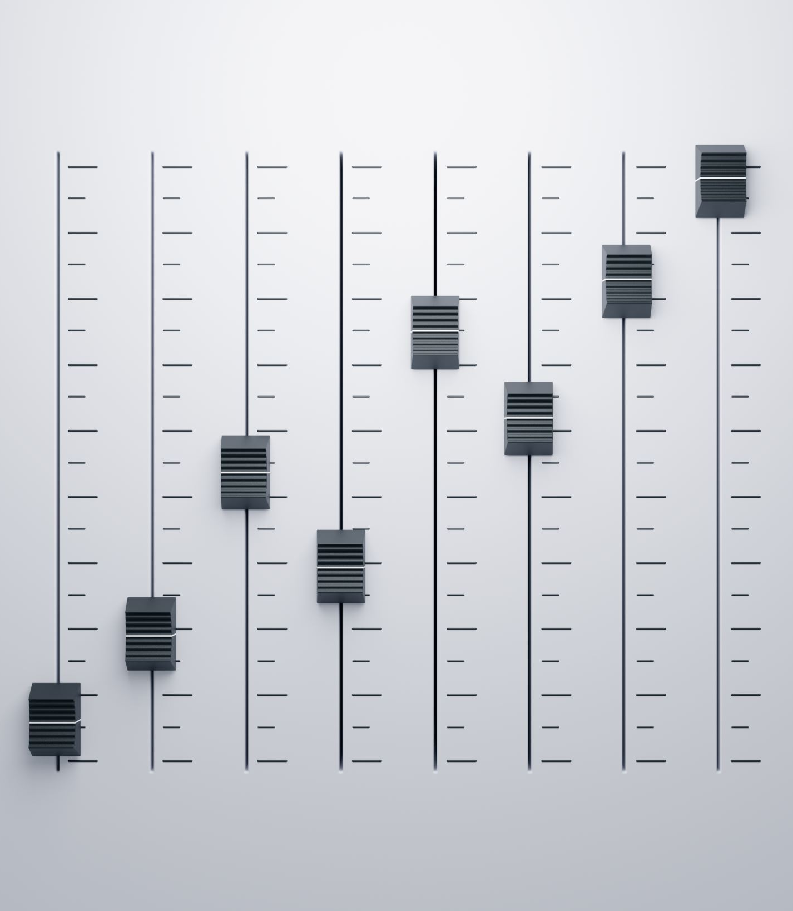
Model Tuning
To improve performance, model tuning was performed using GridSearchCV with 5-fold cross-validation. This allowed us to systematically test different hyperparameter combinations and select the best-performing configuration for each model.
Parameters such as the regularization strength and kernel type for SVM, and depth and number of estimators for tree-based models, were tuned. This process significantly improved model accuracy and helped reduce overfitting, leading to better generalization on unseen data.

Slide 8

Evaluation Metrics
Model performance was evaluated using several standard classification metrics. These include accuracy, precision, recall, and F1-score, which provide insight into both overall performance and class-level behaviour.
Confusion matrices were used to visualise correct and incorrect predictions across anaemia types. In addition, ROC curves and AUC values were used to assess how well the models separate classes, which is especially important in the presence of class imbalance.

Slide 9

Logistic Regression
Logistic Regression achieved moderate accuracy after tuning and served as a useful baseline model. Its main strength lies in its simplicity and interpretability, which is valuable in medical contexts.
However, the model struggled to fully capture complex, non-linear patterns in the data. As a result, its performance was lower compared to more advanced models, particularly for minority anaemia classes.

Slide 10

Support Vector Machine
The tuned Support Vector Machine model performed strongly, achieving approximately 91% accuracy. It demonstrated good class balance and showed improved detection of minority anaemia types compared to Logistic Regression.
SVM was particularly effective at forming clear decision boundaries after proper scaling and tuning. This made it one of the strongest individual models in the study.

Slide 11

Decision Tree
The Decision Tree model achieved very high accuracy, close to 98%. It was able to capture non-linear relationships in the data and produced highly interpretable decision rules.
However, a key limitation of Decision Trees is their tendency to overfit, especially when trained on complex datasets. While performance was strong, this risk needed to be considered when selecting a final model.

Slide 12

Random Forest
Random Forest achieved approximately 96% accuracy and showed excellent generalization performance. By combining predictions from multiple decision trees, it reduced overfitting and produced more stable results.
This model handled class imbalance well and performed consistently across both common and rare anaemia types, making it a very reliable option.

Slide 13
Gradient Boosting
Gradient Boosting also delivered high accuracy and strong performance across most classes. It was effective at handling complex feature interactions and class imbalance.
However, its performance was slightly less stable compared to Random Forest, particularly across different validation folds.

Slide 14

ROC Curve Insights
ROC curve analysis showed high AUC values for most models, especially the ensemble methods. This indicates strong class separability and reliable probability-based predictions.
The results confirm that tree-based ensemble models and SVM are particularly effective for distinguishing between different anaemia types.

Slide 15

Overfitting Check
To check for overfitting, cross-validation accuracy was compared with test accuracy. The results showed no significant performance gaps, indicating that the models generalize well to unseen data.
This consistency increases confidence in the reliability of the results.

Slide 16

Final Model Selection
Although the Decision Tree achieved the highest raw accuracy, Random Forest was selected as the final model. This decision was based on its strong accuracy, stability, and superior generalization compared to a single tree.
Random Forest also demonstrated robust performance across all anaemia classes, making it the most dependable choice for practical application.

Slide 17
Conclusion
In conclusion, this study demonstrates that machine learning can effectively support the early detection and classification of anaemia using routine blood test data. While Logistic Regression and SVM performed well, ensemble models such as Random Forest and Gradient Boosting achieved the strongest and most consistent results.
These findings highlight the potential of machine learning as a clinical decision-support tool, particularly in settings where rapid and accessible screening is needed. With further validation, such models could help improve early diagnosis and patient outcomes.

